Slide 1
GAN
2018/7/11

Slide 2
Preface
Topics
Experiences & tricks
Paper Survey
MuseGAN, MidiNet Review
Outline
GAN Review
Road Map
Condition
Video

Slide 3
Road Map
topics
models
Wasserstein
Distance
WGAN
WGAN-gp
SNGAN
PG-GAN
Layer-wise
Stack GANs
GAN
Projecton GAN
ACGAN
DCGAN
Condition
cGAN
(unsuprvised)
disentanglement
(suprvised)
Improved GAN
cycleGAN
Domain separation
domain
(unpaired)
coGAN
video
TGAN
VGAN
mocoGAN
text
SeqGAN
LeakGAN
MaskGAN
(RNN, RL)

Slide 4
GAN Review
Data & Generator
Discriminator
Training
Testing
Discussion

Slide 5
Review:
How to start a GAN project?
Data
Generator
Discriminator
Training
Testing
State-of-the-art?
Models:
DCGAN
WGAN-gp
SNGAN
* https://www.reddit.com/r/MachineLearning/comments/890prh/r_memgen_memory_is_all_you_need_generative/
Notes:
How to start a GAN project?
I will discuss it in 5 topics
Before start the discussion. Let’see what is the state-of-the-art GAN model?
This comment is from reddit. It says …… is our current best solution
In this talk, Iwill introdcue SNGAN. But I won’t discuss PG ad project.
In addition, I will introduce another two common models. DCGAN and WGAN gp

Slide 6

Data & Generator
No matter what your task is, Normalization on data is necessary.
The activation of the output layer of the generator depends on the range of the data
Bounded
[-1, 1] tanh
[0, 1] sigmoid
Unbounded
zero means unit variance
logarithm (ex: on spectrogram)
leaky ReLU, ReLU?
SharedArray & Shuffle data by index at runtime
z: sampled from a Gaussian distribution
z
G
Notes:
The first topic is how to prepare data and design a generate for it.
Normalization is very essential
And after norm, depending on your value range of your data. Select a proper activation for it.
If the data is too large, the IO will be very slow, So I suggest use SharedArray to load your data on your memory. And shuffling the index of data at runtime.
It’s better to

Slide 7
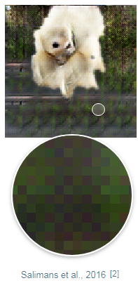
Generator
Batch Normalization is essential to the quality
Upsampling Layers:
Deconvolution (transposed convolution)
The most common method
Checkerboard artifacts?
Resize-Convolution
- ex: PG-GAN uses nearest neighbor upscaling
Pixel Shuffling
Super resolution
Residual Blocks can enhance the quality as well, especially when the size of the images is large and the corresponding network is deep.
* PG-GAN: https://arxiv.org/pdf/1710.10196.pdf
* https://distill.pub/2016/deconv-checkerboard

Slide 8
Discriminator
Loss function:
DCGAN
WGAN-gp
SNGAN
BN applied
Sigmoid output
No BN
No Sigmoid
No BN
Spectral Norm
No Sigmoid
Original GAN loss:
D Loss: - log ( D( X )) - log (1 – D(G( z ))
G Loss: log (1 - D(G( z )) )
Original GAN loss:
D Loss: - log ( D( X )) - log (1 – D(G( z ))
G Loss: - log ( D(G( z )) )
DCGAN
Minimize!!
In practice…

Slide 9
Discriminator
WGAN loss:
D Loss: - log ( D( X )) + log ( D(G( z )) )
G Loss: - log ( D(G( z )) )
SNGAN
Minimize!!
remove log
Gradient penalty:
D Loss: - log ( D( X )) + log ( D(G( z )) ) + (∥∇x D(x)∥ - 1) ²
G Loss: - log ( D(G( z )) )
WGAN-gp
Minimize!!
penalty
Parameter Updating:
1 update G once every 5 updates of D
WGAN-gp

Slide 10
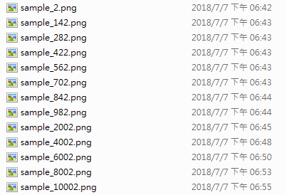
Training
When to stop?
How to monitor the training procedure?
GAN Losses cannot truly reflect the quality (even for WGAN)
Generate samples along training!
Samples/*.png:
(SNGAN on CIFAR10)

Slide 11
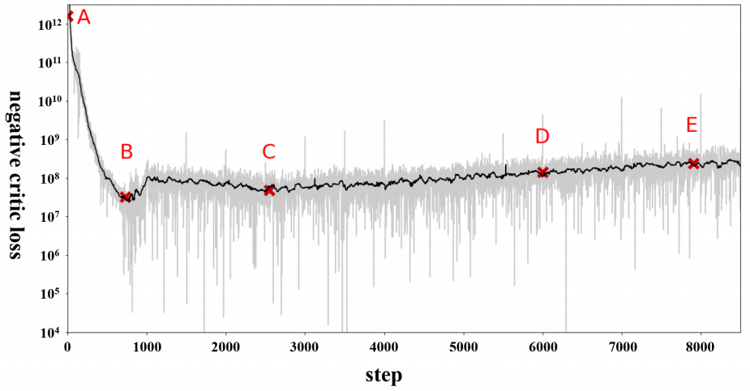
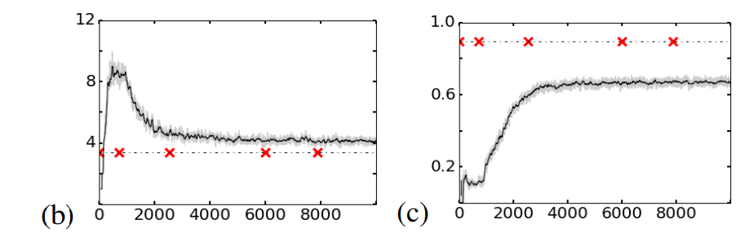
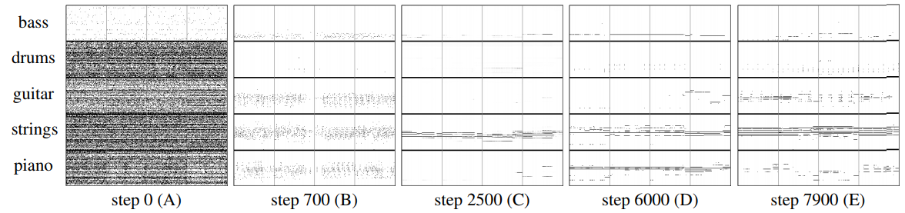
Early Stopping
Evaluate along training!
UPC
QN
* from MuseGAN

Slide 12
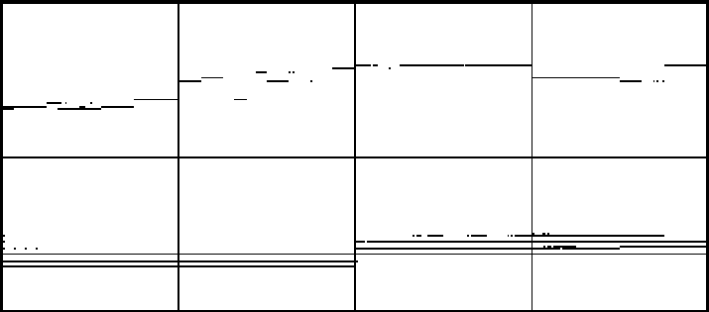
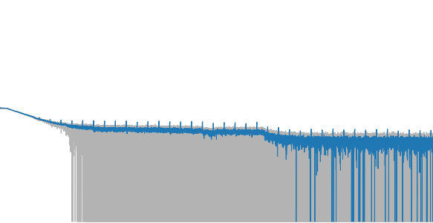
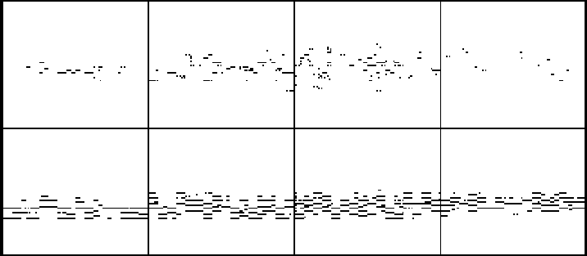
Training
For the first time, train the model for a longer period of time and monitor the procedure.
Possible failure:
Mode collapse
Degeneration
(70K updates)
loss
(130K updates)
updates
70K
* MuseGAN (with WGAN-gp), lead sheet generation

Slide 13
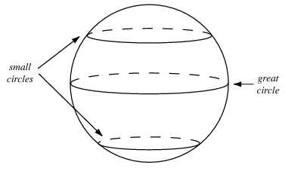
Testing
Interpolation: Spherical (instead of linear)
Batch normalization off
‘is_training’ in TensorFlow
Dropout on?
Image-to-Image (https://arxiv.org/pdf/1611.07004v1.pdf) turns on when testing
Later works seldom use it
* GAN hacks: https://github.com/soumith/ganhacks
* Figure: from https://github.com/ptrblck/prog_gans_pytorch_inference

Slide 14
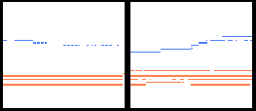
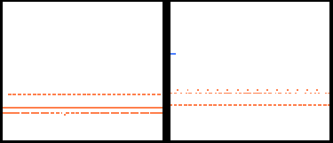
Discussion
So, which model should I use?
Loss
For image, outperforms others in both of th efficiency and the quality.
For discrete (binary) representation, only can generate results successfully.
Network design
Deconvolution is simple but powerful
If you aim to generate images with higher
qualities, try to use residual blocks and
resize-upsampling layers.
SNGAN
WGAN-gp
(WGAN-gp on Lead Sheet)
(SNGAN on Lead Sheet)

Slide 15
Conditional
GANs
How to apply condition
Tag? Disentanglement
Discussion

Slide 16
How to apply condition?
Input Concatenation
cGAN: https://arxiv.org/pdf/1411.1784.pdf
Feature Map Concatenation
DCGAN: https://github.com/carpedm20/DCGAN-tensorflow
Auxiliary Classifier
ACGAN: https://arxiv.org/pdf/1610.09585.pdf
Encoder
S² GAN, Generative Adversarial Text to Image Synthesis
MuseGAN/MidiNet: https://arxiv.org/pdf/1703.10847.pdf
FTGAN: https://arxiv.org/pdf/1711.09618.pdf
Projection Discriminator (ICLR, 2018)
https://arxiv.org/pdf/1802.05637.pdf
Principle:
Both of G and D need to receive the conditional information.

Slide 17
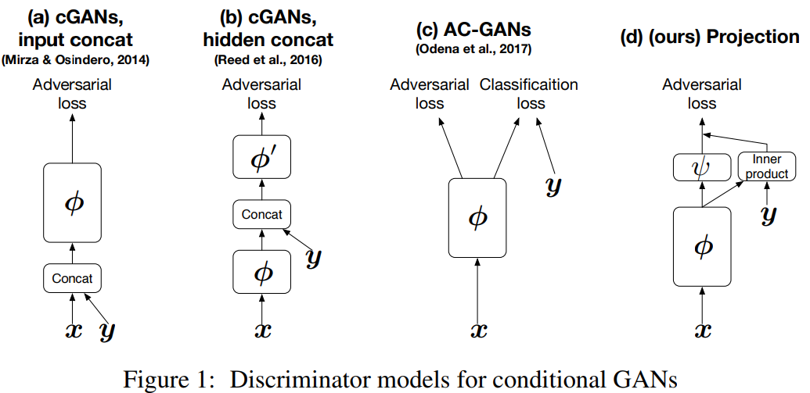

Slide 18
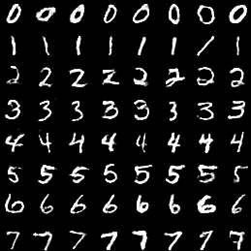
Concatenation
The most common method, naive but practical.
vector concatenation (for linear layer, input z)
one-hot
label
Feature map concatenation (for convolution layer)
condition
maps
conv maps
(SNGAN on MNIST)

Slide 19
Auxiliary Classifier
Or with only auxiliary loss
Where should I concatenate labels? Every layer in G & D?
It depends. Layers which is responsible for higher level features have priorities.
Conditional generation is still a challenging task.
SNGAN + projection discriminator achieve promising results.
Adversarial loss
Cross Entropy (Categorical)
G
D
Q
Mean Square Error (Continuous)
concat
Classifier
(optional)
labels
* cods: https://github.com/pfnet-research/sngan_projection

Slide 20
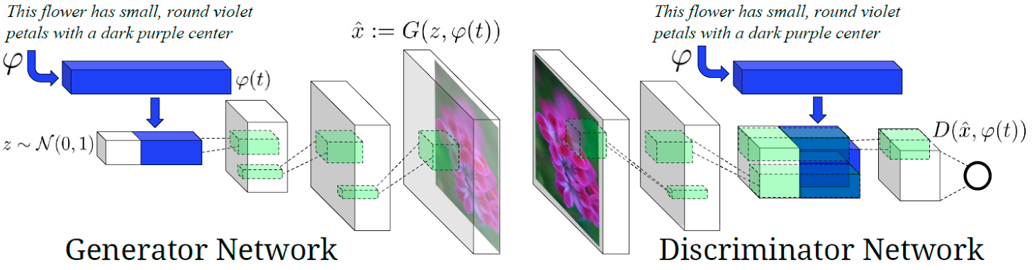
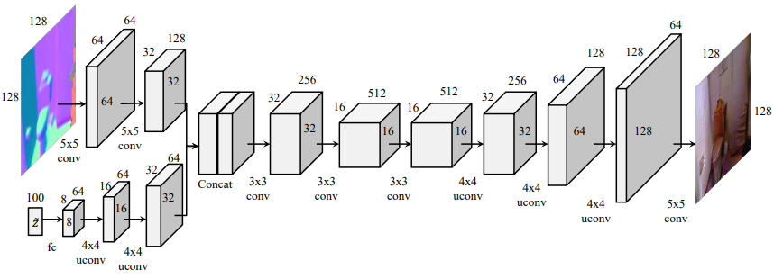
Encoder
For more complex conditional vectors
Motivation: guide the generation process
Generative Adversarial Text to Image Synthesis
S² GAN: Generative Image Modeling using Style and Structure Adversarial Networks

Slide 21

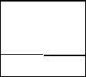
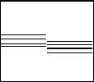
U-Net Encoder
Encoder
Skip-connection: no information loss
MidiNet: previous bar
MuseGAN: accompanied track
Generator
Skip connection
MidiNet
melody
( bar = t – 1 )
melody
( bar = t )
MuseGAN
z
Chord
( bar = t )

Slide 22
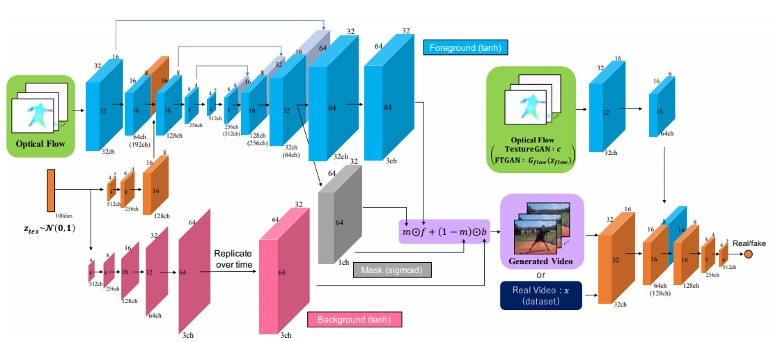
U-Net Encoder
FTGAN (video generation)
Use conditional vector to guide the generation
U-Net
* Optical flow: a feature about motion

Slide 23
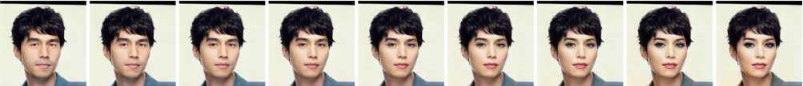
Tag
Supervised GAN training
Conditional generation
Given a class, generate images according to that
Disentanglement
Try to acquire the attribute-invariant latent space
or the controllability with limited labels (Ex: Gender)
Related Works:
DR-GAN
TD-GAN
Fader Network
StarGAN (CycleGAN)
(male -> female) from Fader Network

Slide 24
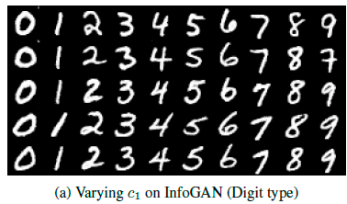
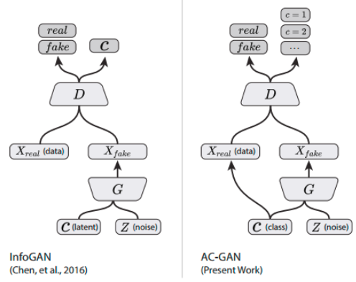
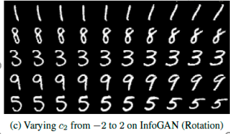
Disentanglement
Unsupervised?
infoGAN
add mutual information loss to encourage latent codes learn the most obvious properties
Mutual info
loss
(categorical)
No label for D
Sampled from
distributions
(continuous)

Slide 25
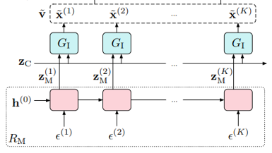
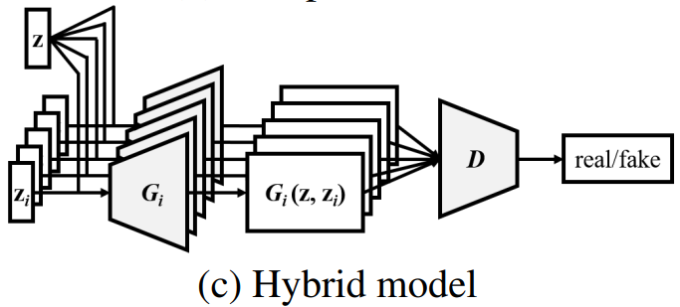
Disentanglement
Unsupervised
mocoGAN & MuseGAN
Design reasonable network architecture to encourage latent codes learn the variant and invariant properties
Both of works simply use 3DCNN in D
t = 1
t = 2
mocoGAN
MuseGAN

Slide 26




Discussion
Previous bar as condition (MidiNet)
For melody
For multi-track
Good
Given
t = 0
Generated
t = 1
t = 2
t = 3
Failed!
Reasons:
The source and target domain are the same
There are too many possible results
Finally, the network tries to copy and paste (AE, instead of U-Net)
Conditional
generation
* MidiNet on multi-tracks

Slide 27
Video GANs
Related Works
Discussion

Slide 28
Video Generation
Early papers try to predict the next frame
MidiNet
Recent works
VGAN
TGAN
mocoGAN
FTGAN
It’s too difficult to generate a sequence of images directly.
Decomposition the video
VGAN: foreground and backgrounf
mocoGAN: content and motion
Using additional information to guide the generation
FTGAN: optical flow

Slide 29
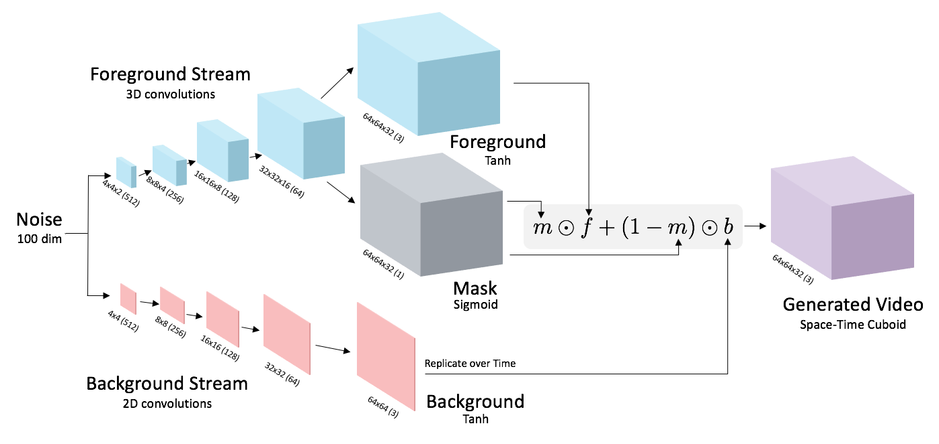
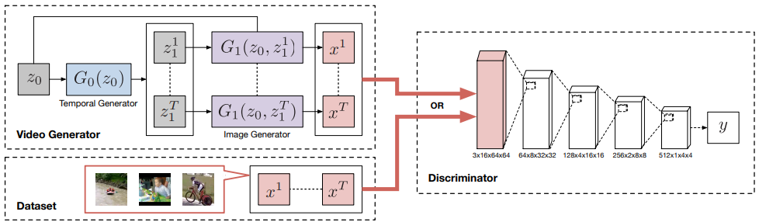
Video Generation
Problems?
From one point at
the latent space!
( VGAN )
( TGAN )

Slide 30
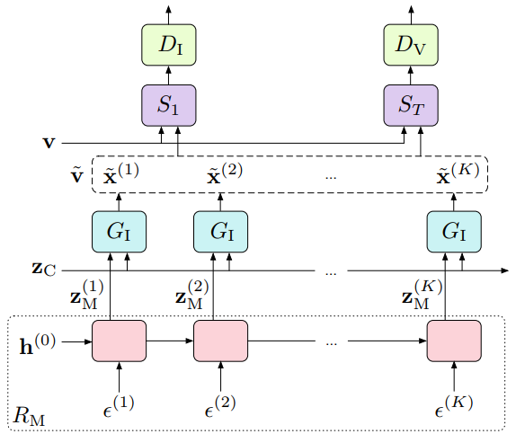
Video Generation
Sliding 3DCNN
Discriminator
GIF generation
No scene transitions
3DCNN discriminator only ensure
every local block of frames is true
Content invariant
( MocoGAN )

Slide 31
conclusion

Slide 32
Video Generation
GAN templates:
Chainer:
https://github.com/pfnet-research/chainer-gan-lib
https://github.com/pfnet-research/sngan_projection
Tensorflow:
https://github.com/carpedm20/DCGAN-tensorflow
https://github.com/wiseodd/generative-models
Pytorch:
https://github.com/eriklindernoren/PyTorch-GAN

Slide 33
END

Slide 34
Text GANs
Related Works
Discussion

